Slide 1

employee data analysis using excel
STUDENT NAME : Sam rathinaraj . S
REGISTER NUMBER : 312211667
DEPARTMENT : bcom(general)
COLLEGE : THIRUTHANGAL NADAR COLLEGE

Slide 2
PROJECT TITLE
employee performance analysis using
Excel

Slide 3

Problem statement
Project overview
End users
Our solution and proposition
Data set description
Modelling approach
Results and discussion
Conclusion

Slide 4
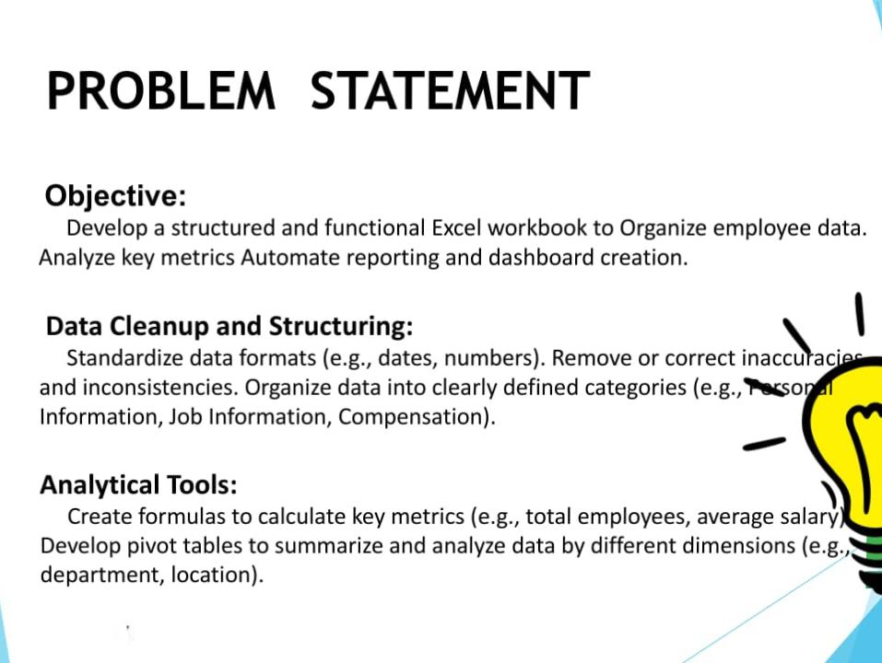

Slide 5


Slide 6
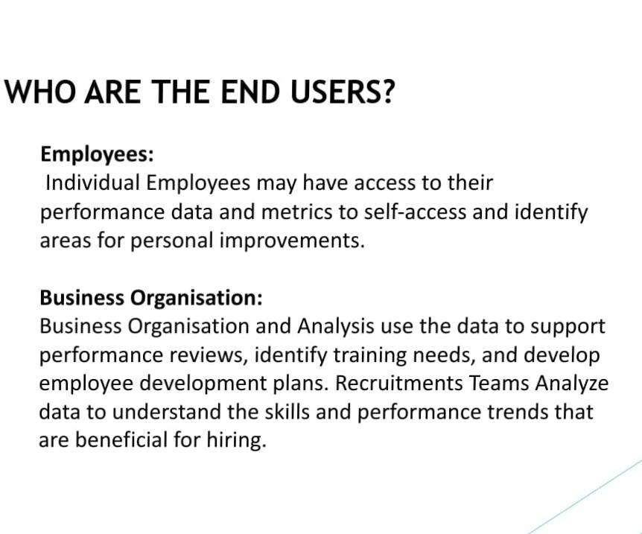

Slide 7
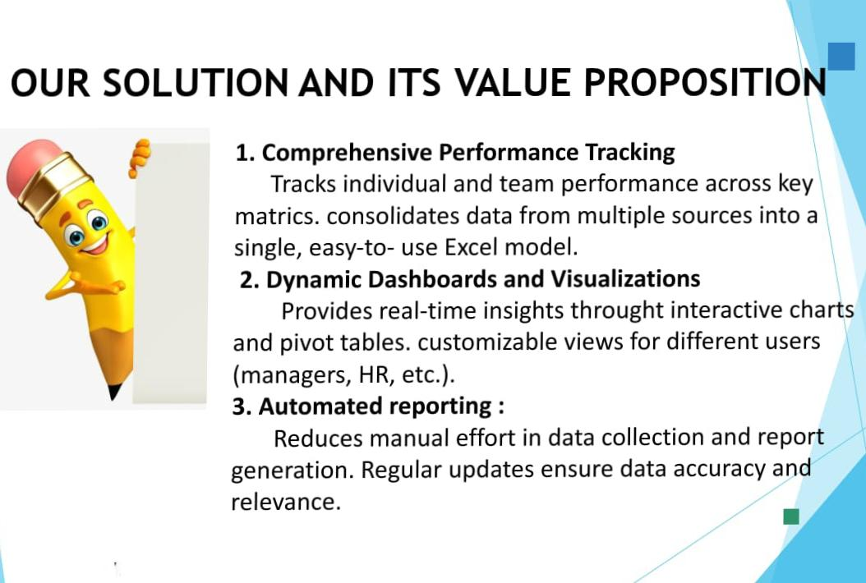

Slide 8



Slide 9

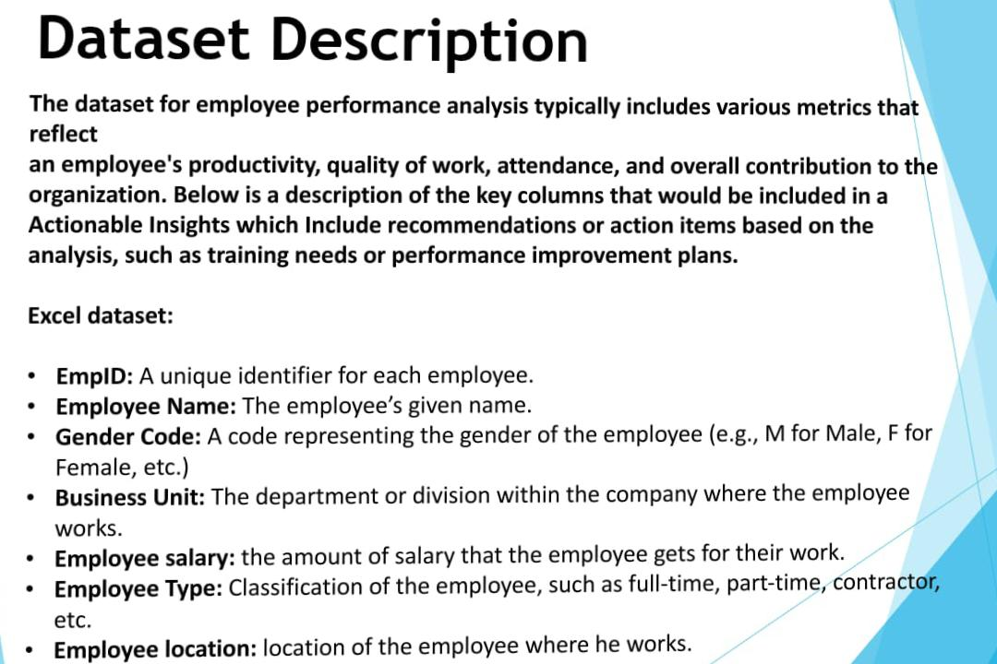

Slide 10
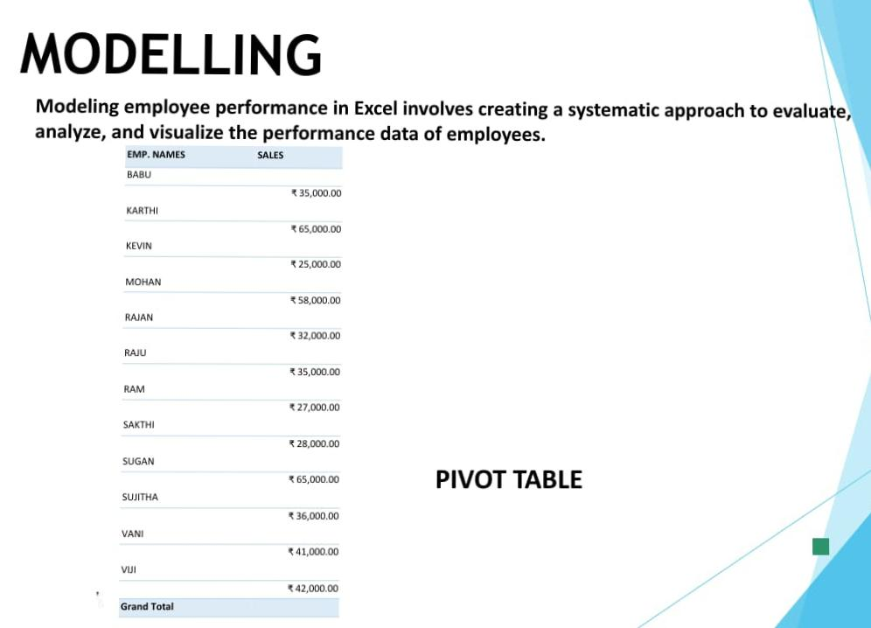

Slide 11


Slide 12
